Slide 1
GROUP 1
VAIBHAVI MILIND CHAUGHULE 204131005
ASHISH MOTIRAM HEMBADE 204130018
AKSHAY SHAILESH MHATRE 204130037
NISHAD RAMESH NANAWARE 204130043
SAKSHI JAGANNATH ROKADE 204131053

Slide 2

FOOTSTEP POWER GENERATION

Slide 3

CONTENTS
INTRODUCTION
TYPES OF ENERGY
BLOCK DIAGRAM
PIEZO ELECTRIC SENSORS
WORKING
APPLICATION
PROS AND CONS
CONCLUSION

Slide 4
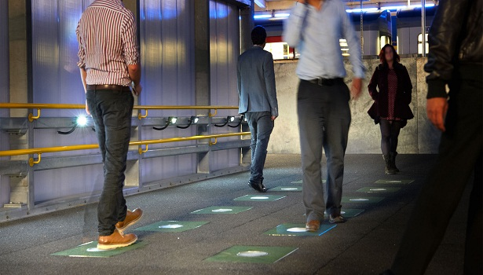
INTRODUCTION
Generating electrical energy power as non conventional method by simply walking on it.

Slide 5
TYPES OF ENERGY SOURCE
CONVENTIONAL ENERGY SOURCE
NON-CONVENTIONAL ENERGY SOURCE
AN ALTERNATE ENERGY SOURCE

Slide 6
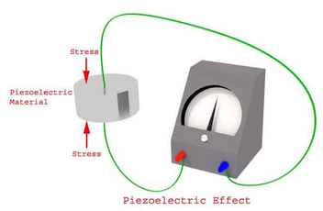
PEIZO-ELECTRIC SENSORS
A sensor which works on the principle of piezoelectricity is known as a piezoelectric sensor.

Slide 7
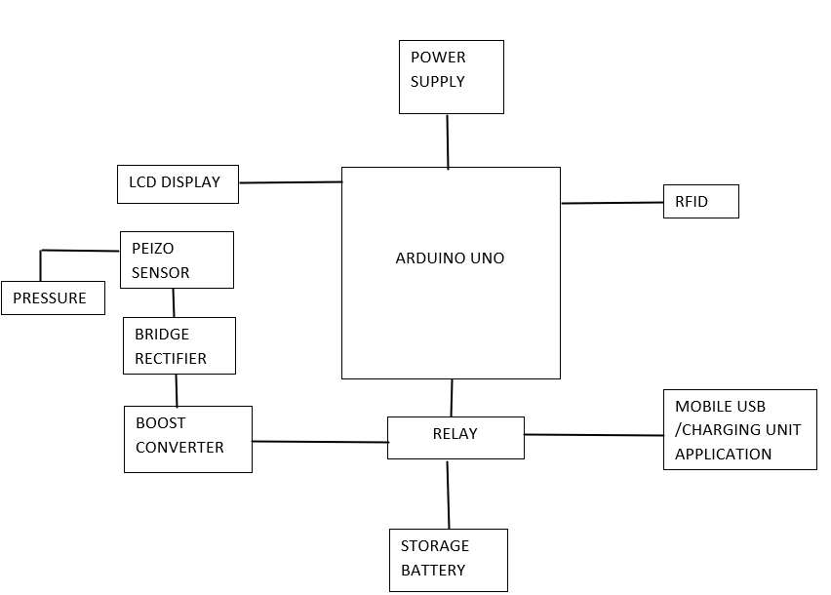
BLOCK DIAGRAM

Slide 8
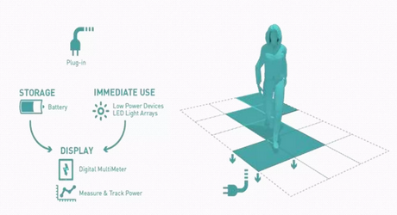
WORKING

Slide 9

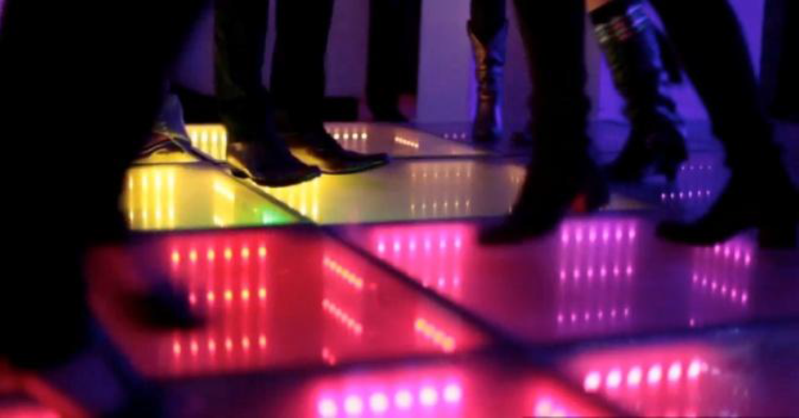
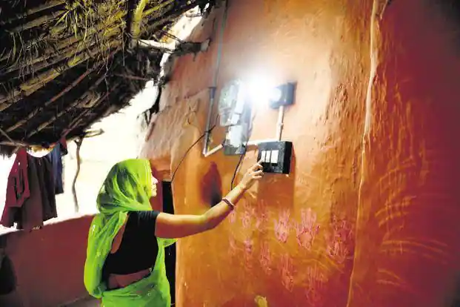
APPLICATION
RAILWAY STATION
DANCING FLOORS
RURAL AREAS

Slide 10

PRO`S AND CON`S
PRO`S
CON`S
RELIABLE.
ECO-FRIENDLY.
ALTERNATE WAY OF POWER GENERATION.
INITIAL COST IS TOO HIGH.
IMPLEMENTATION IS DIFFICULT.
MORE MAINTENANCE.

Slide 11

CONCLUSION
FOOTSTEP POWER GENERATION IS AN ECONOMICALLY, AFFORDABLE ENERGY SOLUTION TO COMMON PEOPLE.

Slide 12
BIBLIOGRAPHY
https://aip.scitation.org/doi/abs/10.1063/1.5118105
https://www.ijraset.com/research-paper/footstep-power-generation-using-piezoelectric-sensor
https://www.smart-energy.com/industry-sectors/new-technology/energy-generated-from-footsteps-can-power-indias-green-revolution-study/

Slide 13


